Slide 1

General Instructions

Slide 2


Predicting Credit Card Limit Using Linear Regression
Data Science

Slide 3
Problem Statement
A financial institution that issues credit cards wants to understand and predict how much credit limit should be granted to each customer based on their demographic and financial characteristics.
Currently, credit limits are often assigned using broad policies or manual reviews, which may not accurately reflect a customer’s true repayment ability or creditworthiness.
This can lead to:
Underestimation of limits, reducing customer satisfaction and usage, or
Overestimation of limits, increasing the risk of default and financial loss
Data Science

Slide 4
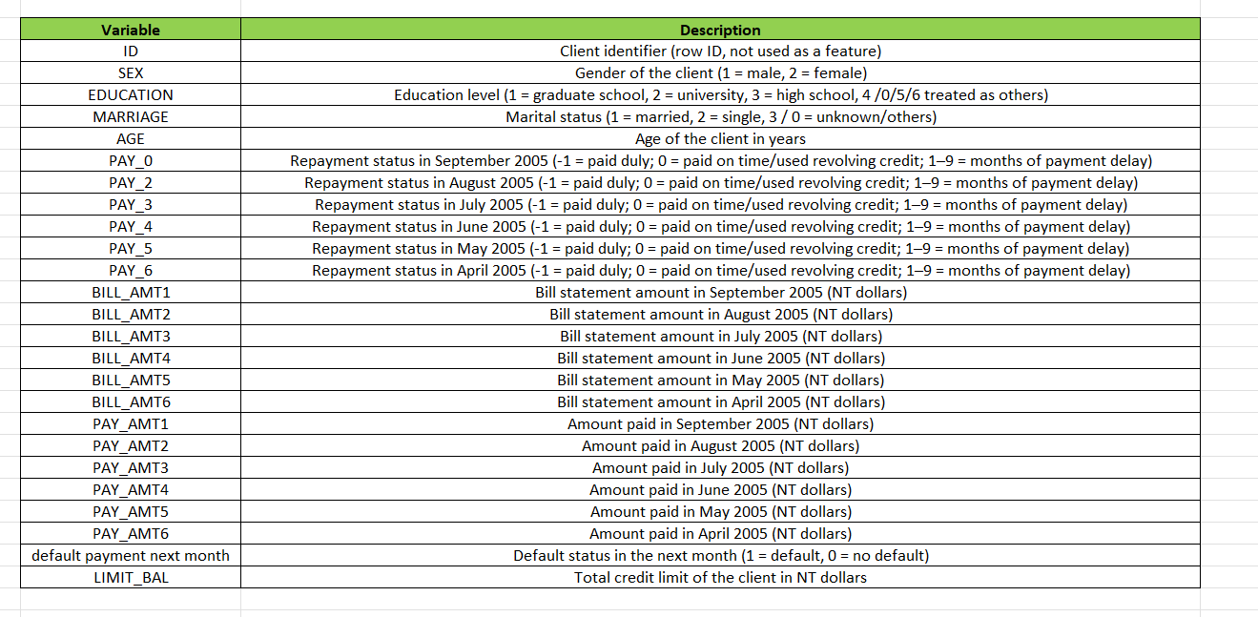
Data Science

Slide 5
Task
Understanding about the data using Preliminary Analysis (info(),describe() etc.)
Data pre-processing
Exploratory data analysis
Model Building
Model Evaluation
Observations with key findings
DDaattaa SScciieennccee
66

Slide 6

THANK YOU

